Slide 1
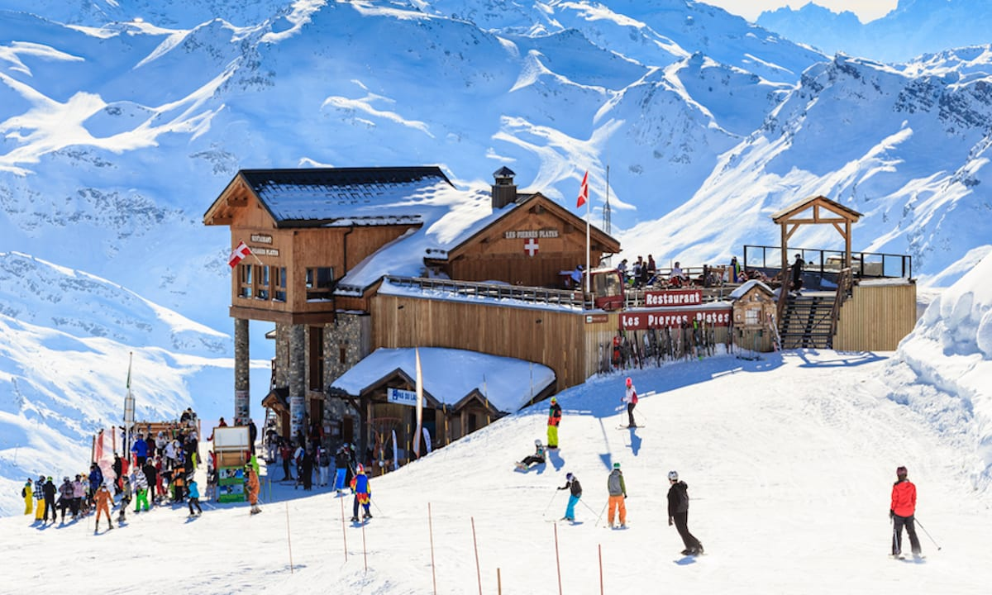
Big Mountain Ticket Price Analysis
Authored by: Michael Palazzolo
05/13/2021

Slide 2
Problem Identification
How can Big Mountain Ski Resort increase the average price point of lift tickets by at least 5% by re-evaluating their pricing model compared to the other players in the US market during the 2021 Ski season?

Slide 3
Context
What?
Evaluate if Big Mountain can justify a price increase to Adult Tickets
Assess and justify the price based on features of the US Ski Resorts
How?
Using data from the Dataset Manager
Using publicly available data and demographics for the states
Create a pricing model based on available and derived features

Slide 4
Guidance and Key Findings
Guidance
A price Increase of $4-6$ is justified based on the pricing model developed from the market analysis
Key Findings
Big Mountain Resorts ski assets are among the top of US resorts in the most important resort features.
A price increase of up to $7.05 is justified by the pricing model.

Slide 5
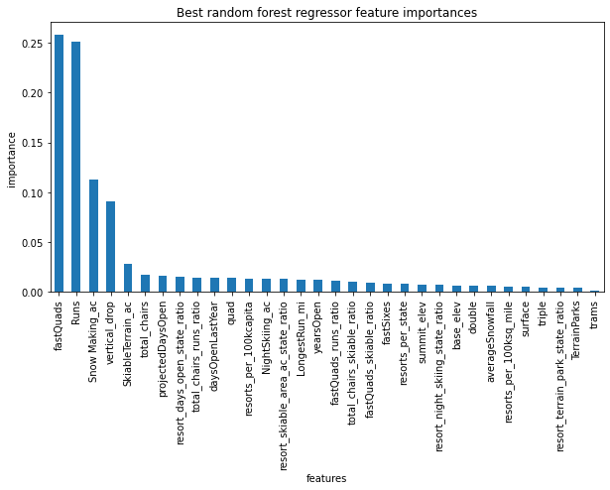
Most Important Resort Features

Slide 6
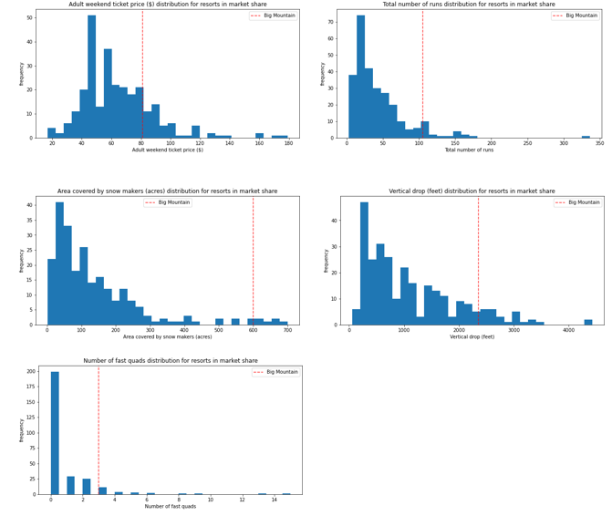
How Does Our Resort Stack Up?

Slide 7
Model and Assumptions
Model
The model included the attributes from the dataset manager as well as derived attributes that reflect the magnitude of ownership of key features of each resort relative to state totals.
Assumptions
Big Mountain gets 350,000 visitors annually
Visitors stay for 5 days in a stint.
It’s not known whether other resorts over or undervalue their ticket prices.

Slide 8
Results
Results
Model Prediction - $98.64
  Prediction Error - $10.59
  $98.64 - $10.59 = $88.05
A price increase of up to $7.05 is justified by the pricing model.
Option 2 – Adding a run, increasing vertical drop by 150 feet and installing an additional lift could enable a $0.76 increase in ticket price if implemented. This could generate $1,333,333 in annual revenue

Slide 9
Summary
Summary
The investigation of the US Ski Resort has led to the conclusion that Big Mountain Resort has undervalued its price per adult ticket which currently stands at $81.
The assets managed by Big Mountain support an increase by as much as $7.05 per adult ticket.

